Slide 1
Thank you for downloading!
OFFICIAL FONT
Midnights
Neue Haas Grotesk Bold
If the official font isn’t working, you can also use the other fonts that should already be installed on your computer.
FREE FONTS
Midnights
Arial Bold
Midnights
Inter

Slide 2
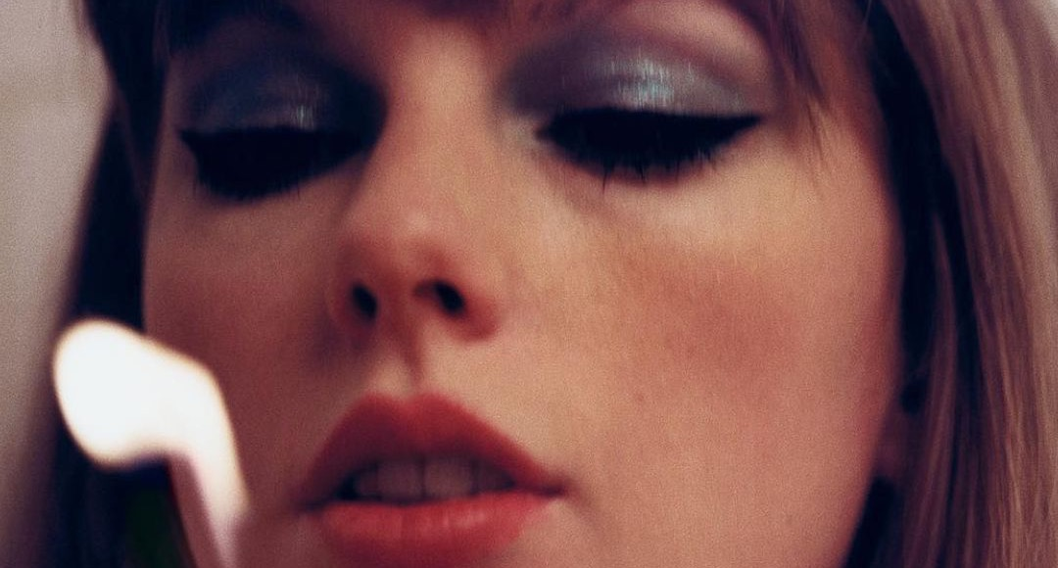
Midnights
Lavender Haze
Maroon
Anti-Hero
Snow on the Beach
You’re On Your Own, Kid
Midnight Rain
Question…?
Vigilante Shit
Bejeweled
Labyrinth
Karma
Sweet Nothing
Mastermind

Slide 3
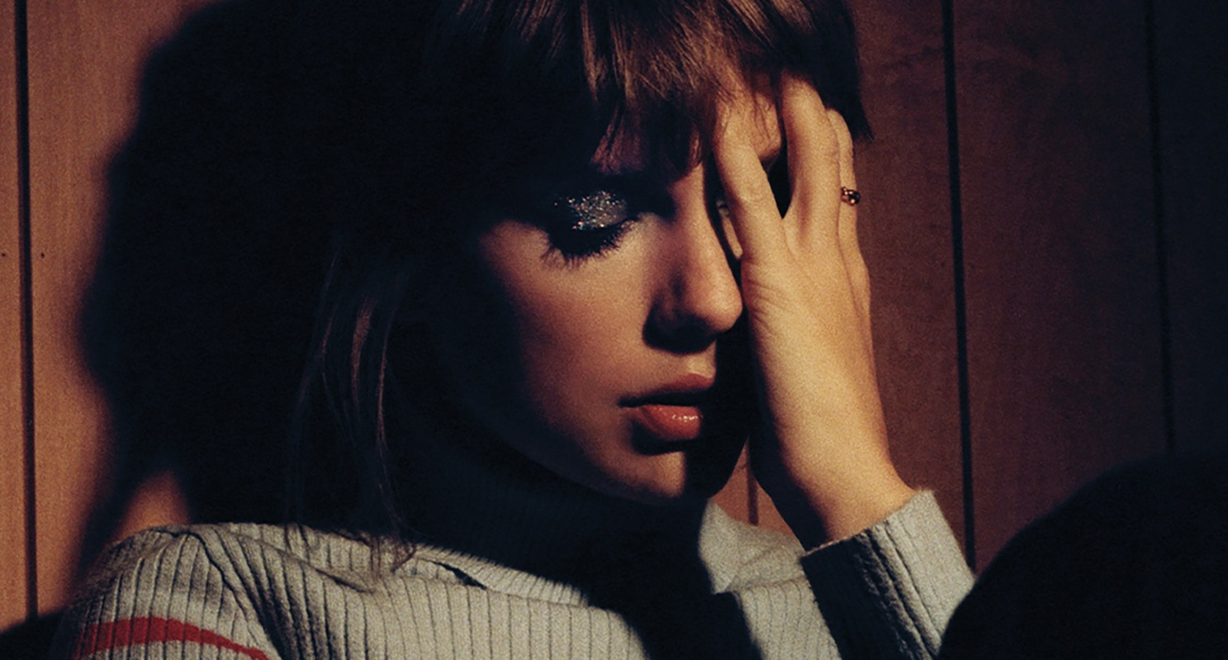
Midnights
Side A
Track One
Track Two
Track Three
Track Four
Track Five
Track Six

Slide 4
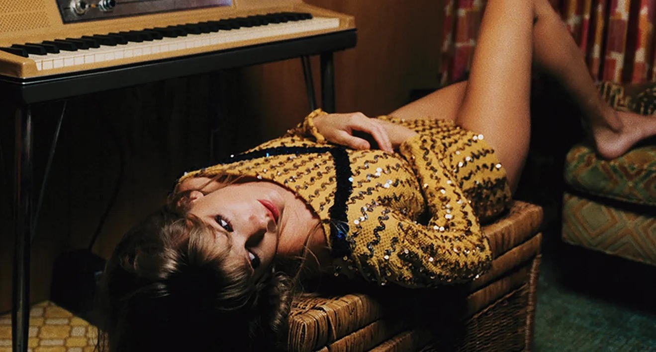
Midnights
Side B
Track Seven
Track Eight
Track Nine
Track Ten
Track Eleven
Track Twelve

Slide 5
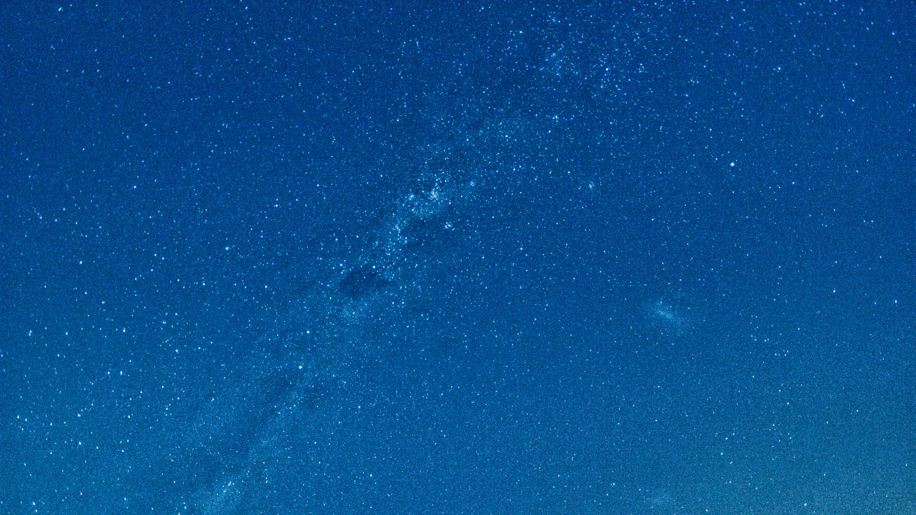
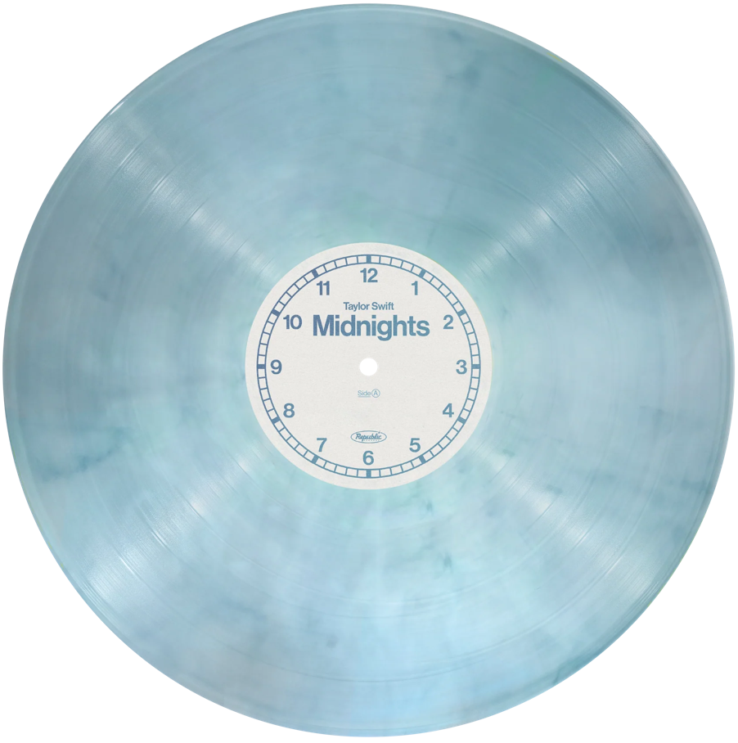
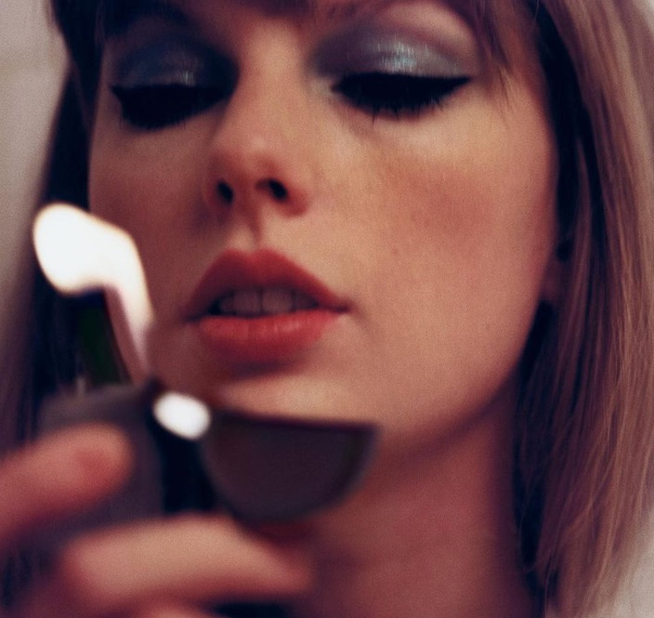
Midnights: Moonstone
--
Lavender Haze
Maroon
Anti-Hero
Snow on the Beach
You’re On Your Own, Kid
Midnight Rain
Question…?
Vigilante Shit
Bejeweled
Labyrinth
Karma
Sweet Nothing
Mastermind

Slide 6
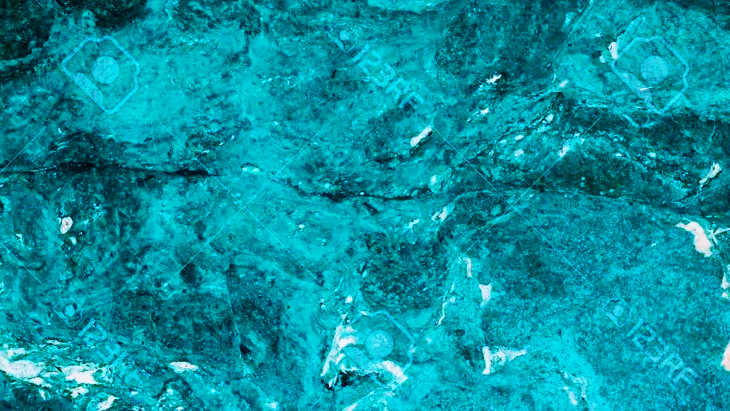
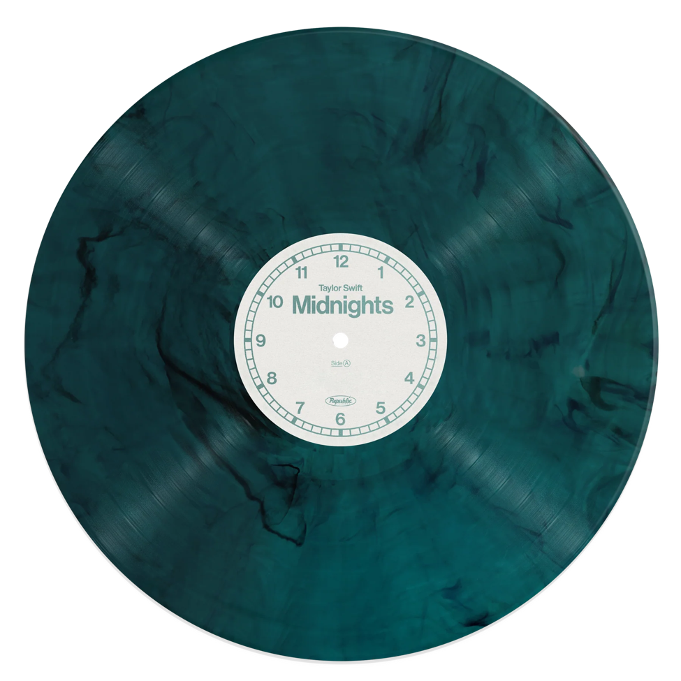
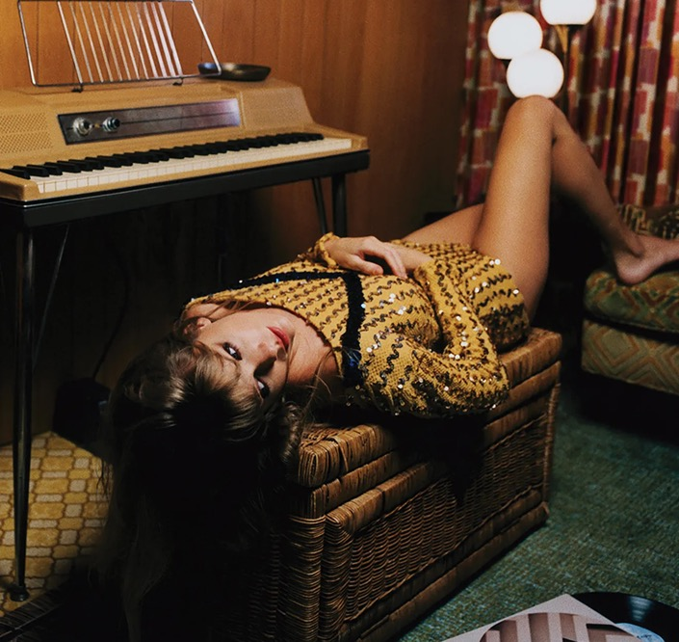
Midnights: Jade
--
Lavender Haze
Maroon
Anti-Hero
Snow on the Beach
You’re On Your Own, Kid
Midnight Rain
Question…?
Vigilante Shit
Bejeweled
Labyrinth
Karma
Sweet Nothing
Mastermind

Slide 7
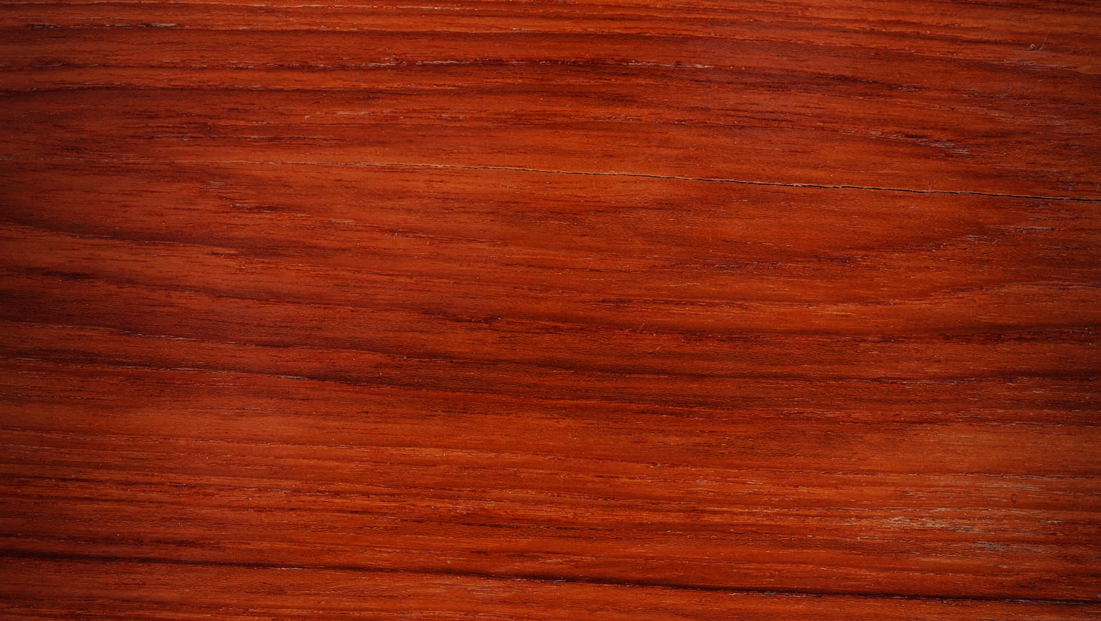
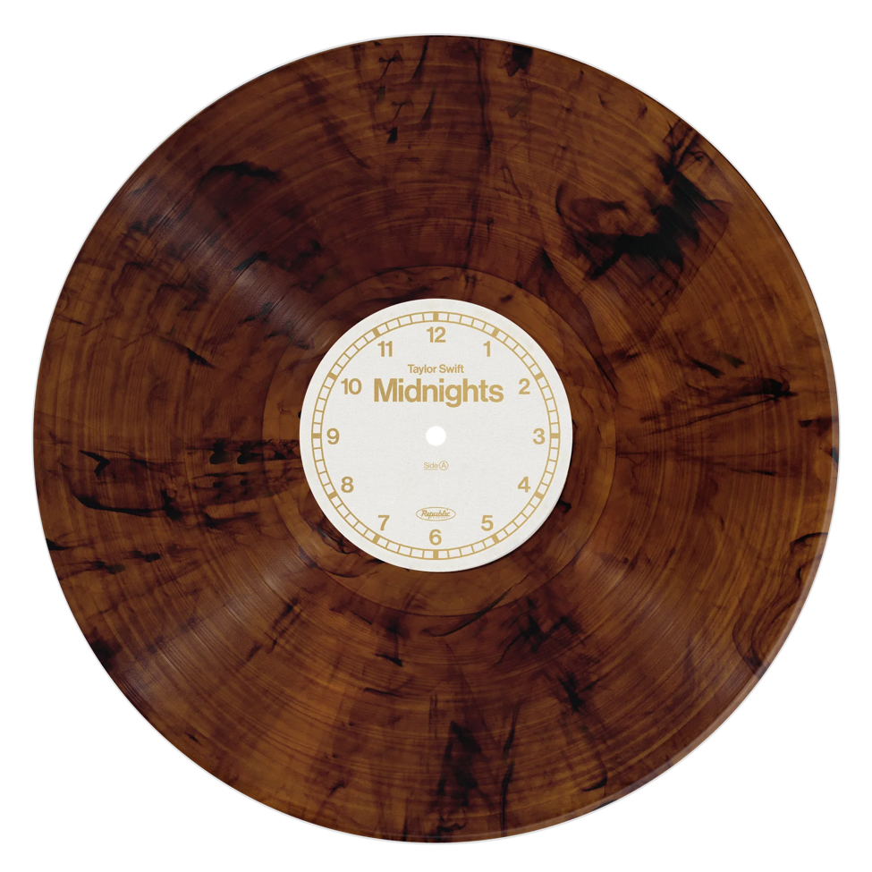
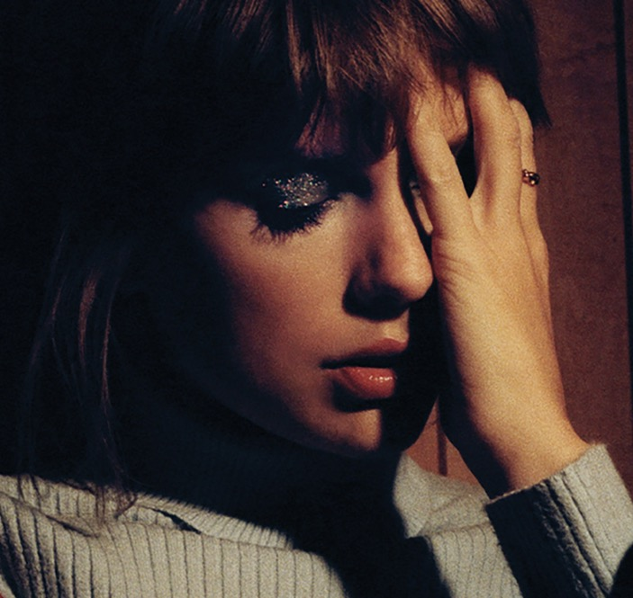
Midnights: Mahogany
--
Lavender Haze
Maroon
Anti-Hero
Snow on the Beach
You’re On Your Own, Kid
Midnight Rain
Question…?
Vigilante Shit
Bejeweled
Labyrinth
Karma
Sweet Nothing
Mastermind

Slide 8
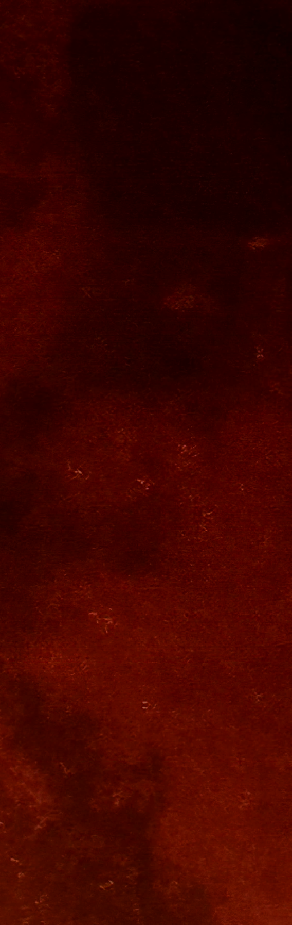
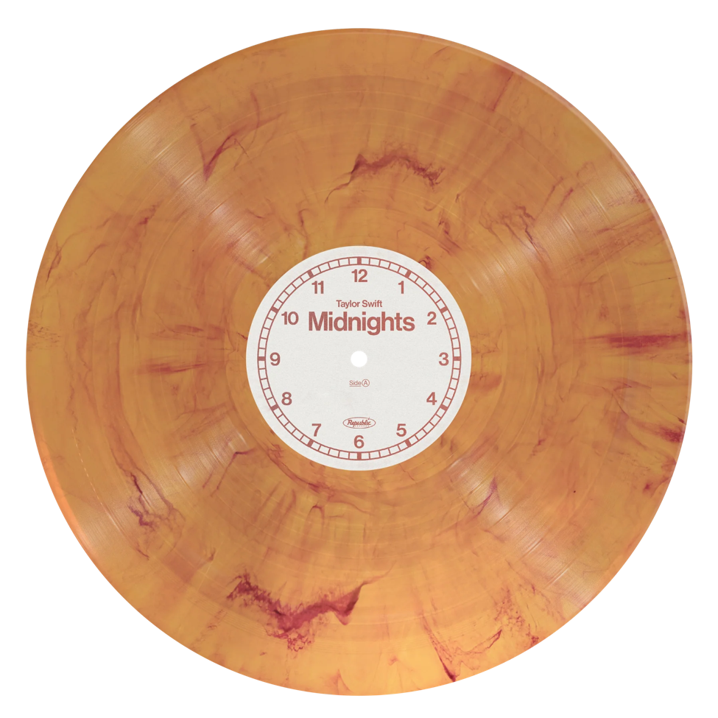
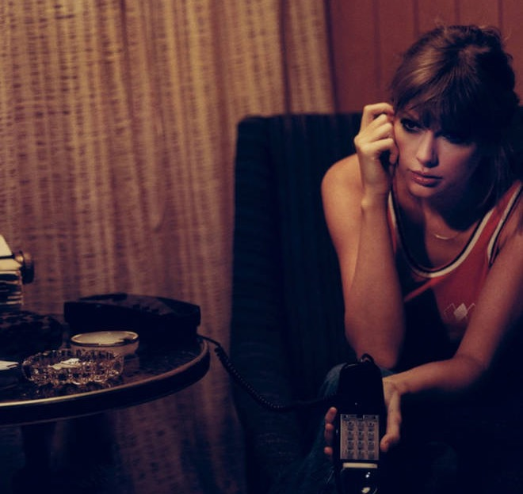
Midnights: Blood Moon
--
Lavender Haze
Maroon
Anti-Hero
Snow on the Beach
You’re On Your Own, Kid
Midnight Rain
Question…?
Vigilante Shit
Bejeweled
Labyrinth
Karma
Sweet Nothing
Mastermind

